Slide 1
SNOWFLAKE PIPELINE
File created on: 3/27/2026 12:57:41 AM

Slide 2


Slide 3
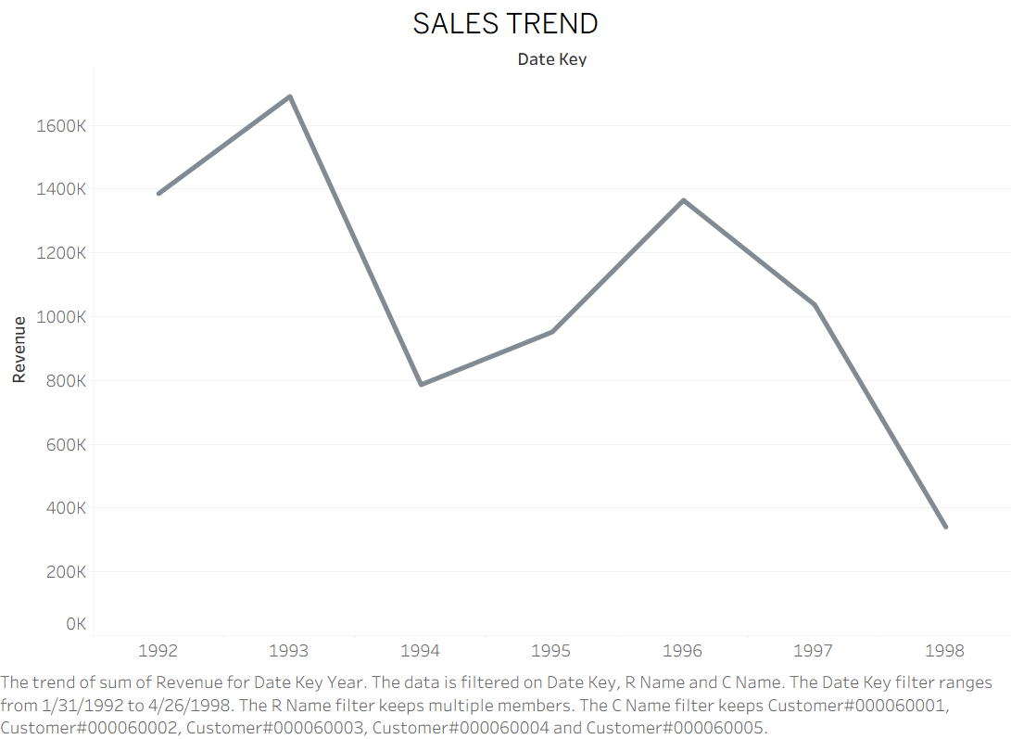

Slide 4
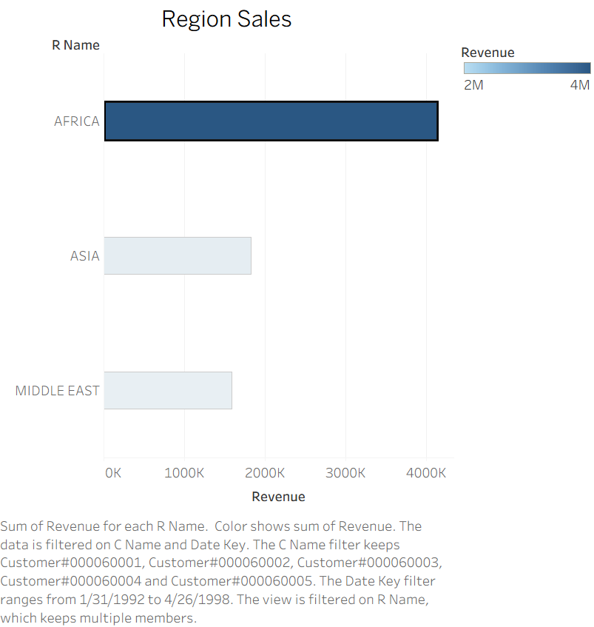

Slide 5
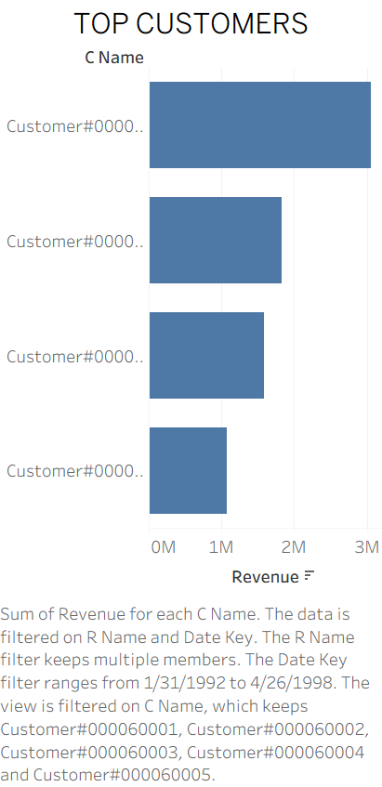

Slide 6
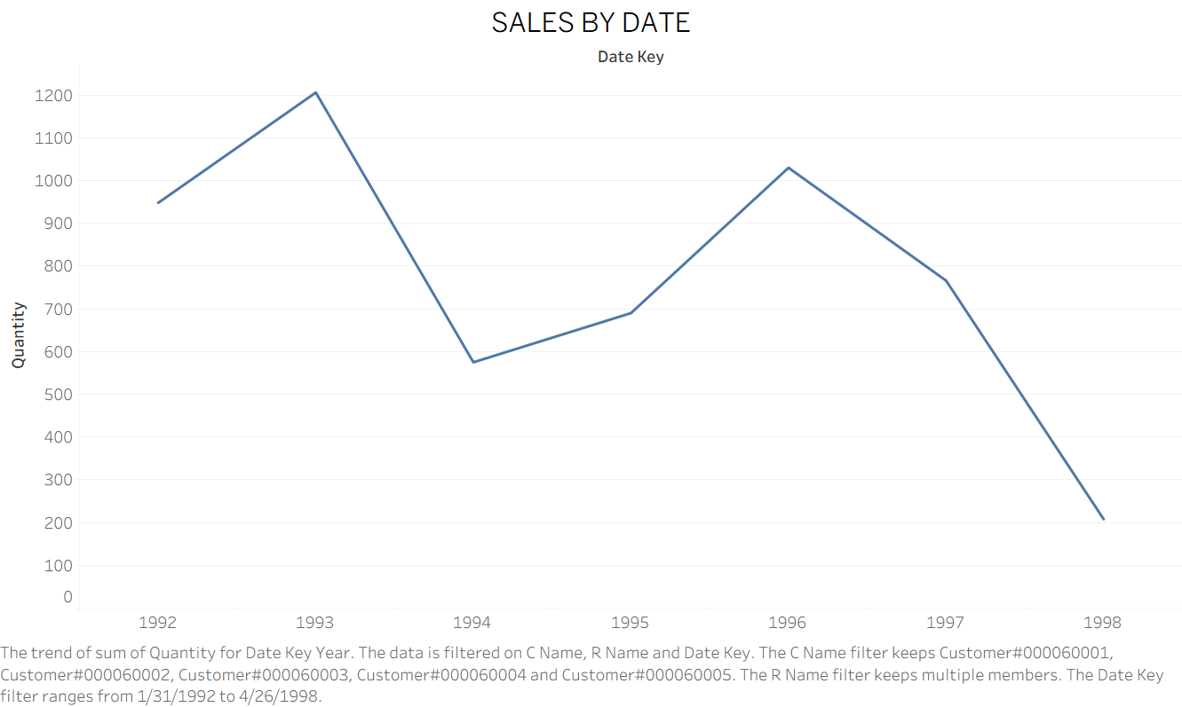

Slide 7
